Slide 1
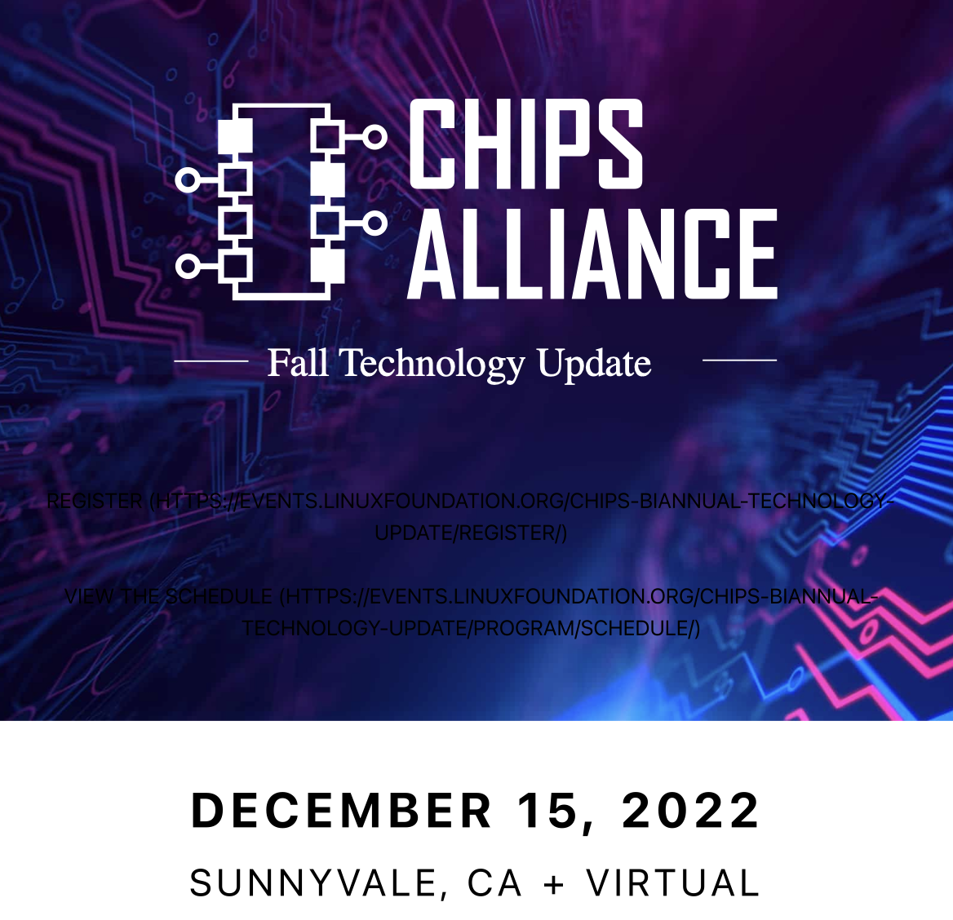

Slide 2


CHIPS Alliance: Fall Technology Update
Rob Mains
General Manager
CHIPS Alliance
Email: rmains@linuxfoundation.org
Phone: +1 408 607 4879

Slide 3
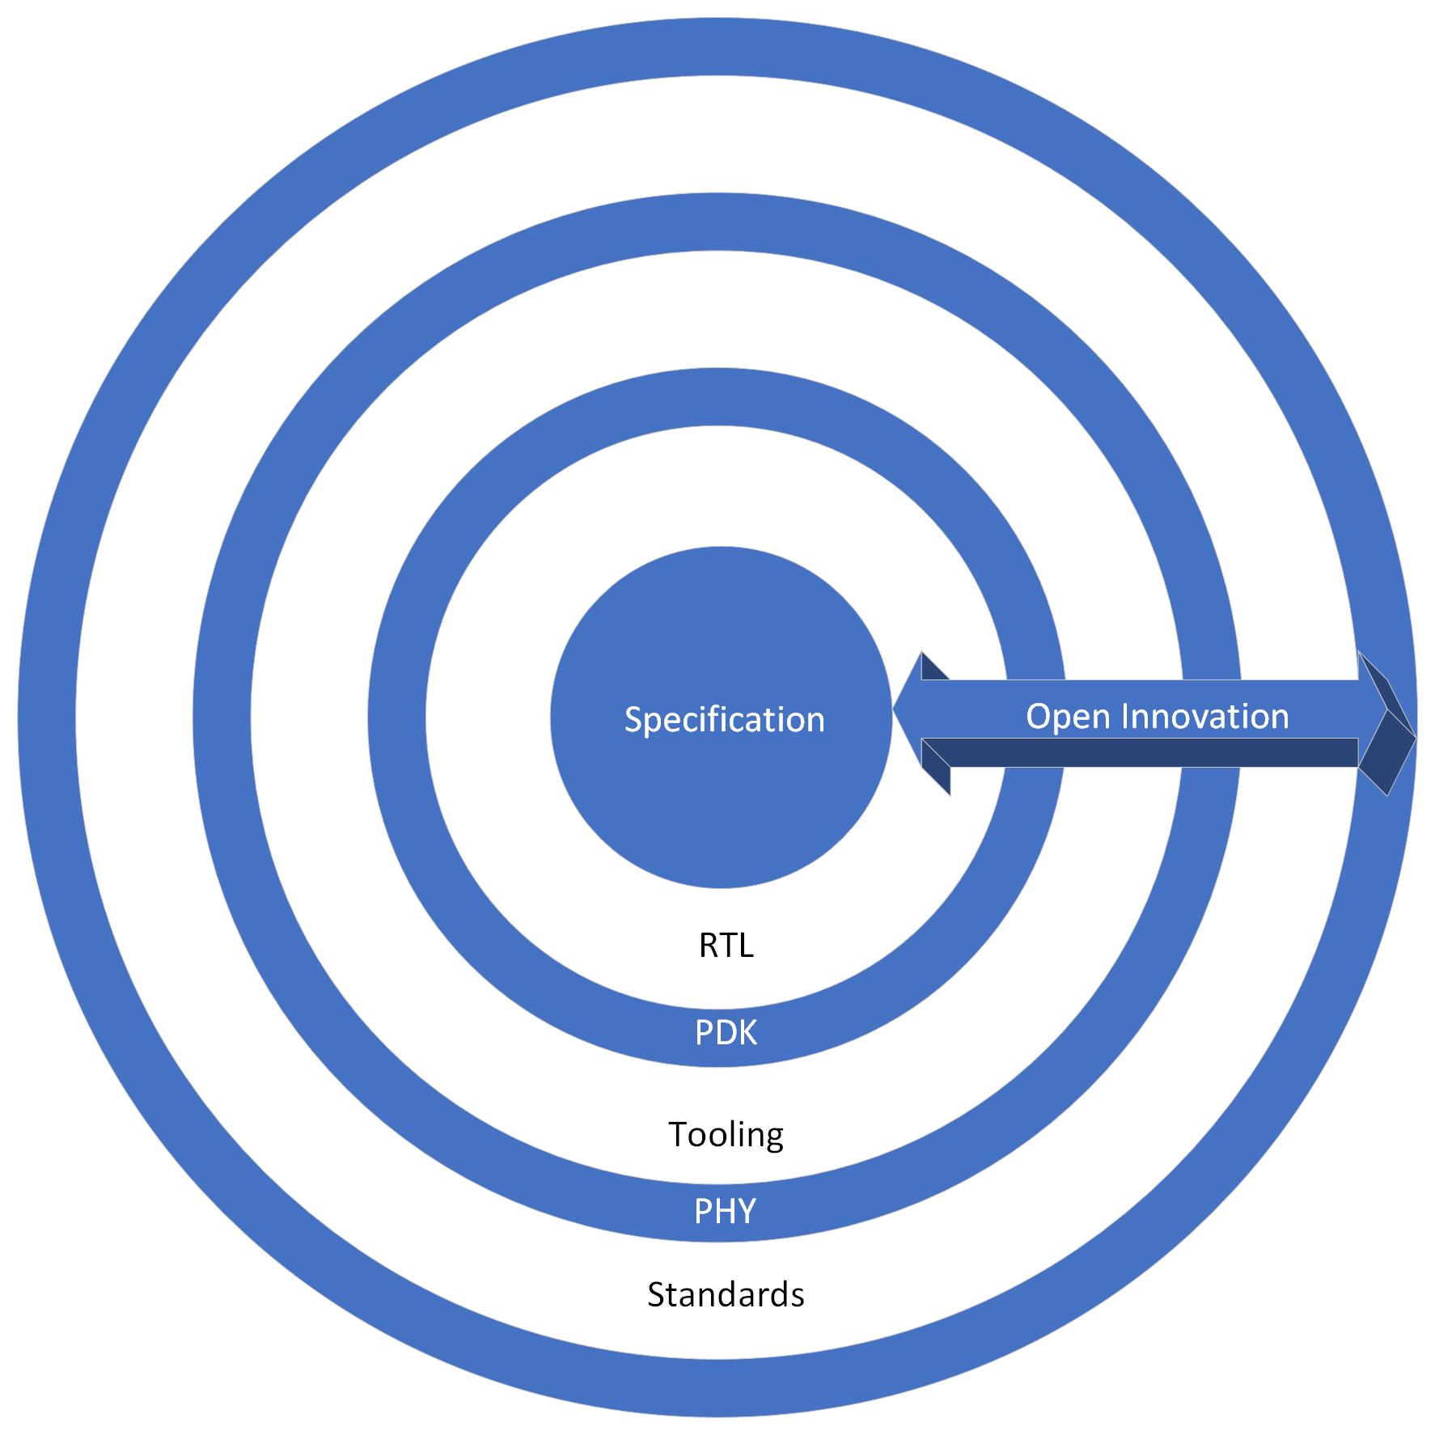
Concentric Collaborative Innovation: Open Design Ecosystem
Many Contributors
Individuals
Universities
Foundations
Companies

Slide 4
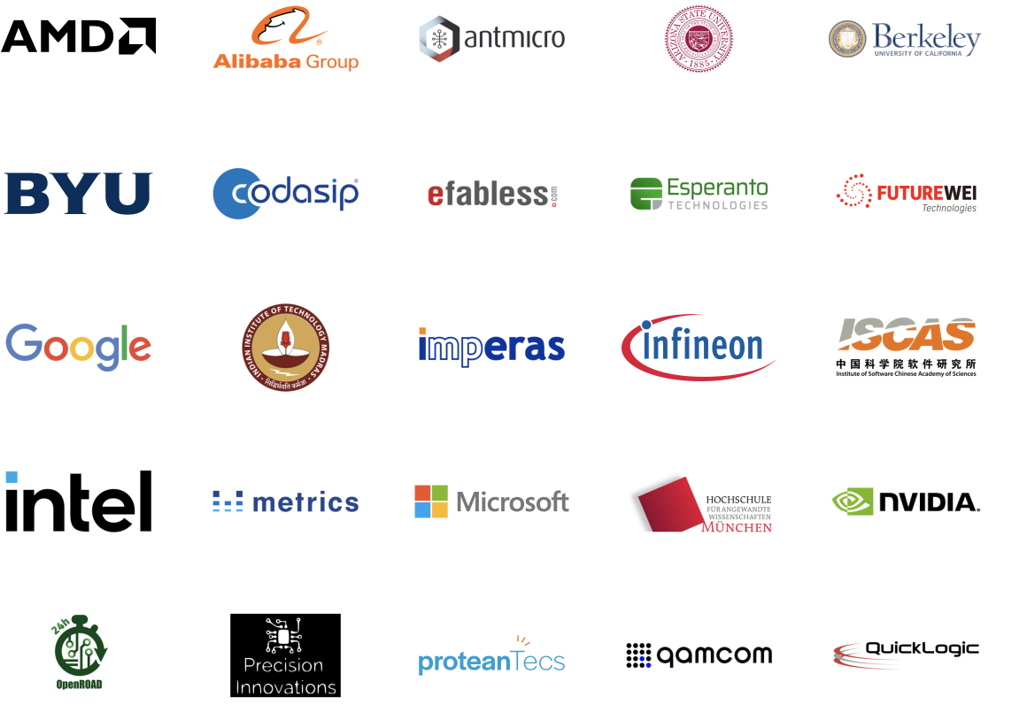

CHIPS Members

Slide 5


Workgroups
F4PGA
Interconnect
Design Entry
Education
Caliptra
Cores
Tools
Analog

Slide 6
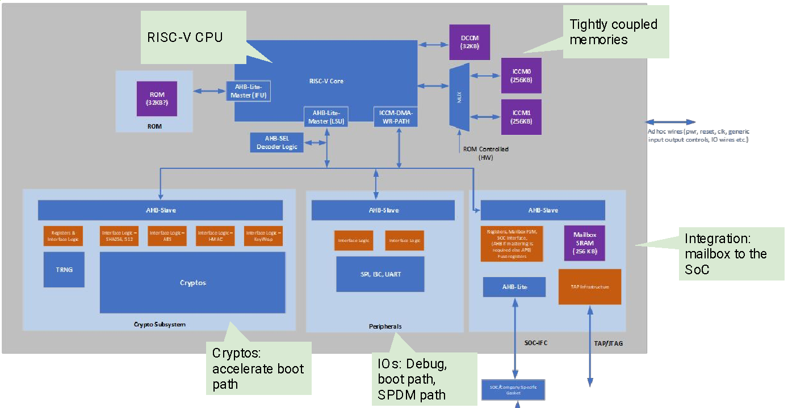
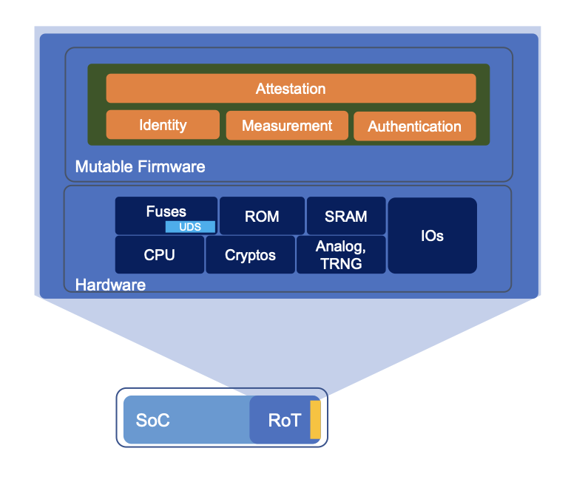

Caliptra: Silicon Root of Trust IP Block
Open source implementation, Apache 2.0 licensed
Reusable
Collaboratively developed
Targeted for Datacenters
Measure, verify, and attest
CHIPS will host Caliptra’s workgroup focused on its implementation and also be the repository for RTL, verification, and firmware.

Slide 7
Putting it all together: Open Design Enablement with Catalog of Trusted Ingredients
Open Source Verified and Trusted IP Component Library
Physical
Macro
Logical
Macro
Cell Library
Verification Testbench
Functional Simulation, Formal, Emulation
Analog Tools
Digital Tools
Design Data Representation
Arch
Implementation Framework
RTL
UVM
Props
Verification and Implementation Platforms

Slide 8
Today’s Speakers
Welcome / Opening Remarks | Rob Mains | CHIPS Alliance
Caliptra | Bryan Kelly | Microsoft
SBOM and HBOM / Zephyr | Kate Stewart | Linux
F4PGA tools in the classroom | Mike Wirthlin; Jeff Goeders | BYU
Datasets for Machine Learning for Chip Design | Aman Arora | University of Texas-Austin
Open source SystemVerilog /UVM support scaling for large designs | Michael Gielda | Antmicro
Lowering barriers to chip design using OpenFASOC, AWG activities and tapeouts | Mehdi Saligane | University of Michigan
Global Foundries Open PDK | Karthik Chandrasekaran | Global Foundries
Caravel SOC Learnings | Mohamed Kassem | Efabless
Intel Compiler for SystemC | Mikhail Moiseev | Intel
Renode co-simulation for Caravel / MPW shuttle | Peter Gielda | Antmicro

